Slide 1
Data Visualization with
Tableau

Slide 2
Agenda
Create the LIMS view
Connect Tableau to the view
Design the visualization
Publish visualization to the Tableau web server
Determine the URL for the visualization
Setup user access to the visualization within Core
End user functionality in LIMS

Slide 3
Why Tableau?
Tableau is a functionally rich data visualization package that enables an analyst to design interactive reports that many users can share
A competitive alternative to Spotfire, especially for data that does not require structures to be rendered within visualizations
For an external tool evaluation see:
http://apandre.wordpress.com/tools/comparison/
Tableau is ranked highest for data integration and visual OLAP(online analytical processing)…

Slide 4
Architecture
Tableau Thick Client
(where visualization is designed)
Core LIMS Server
Core LIMS Database
Core LIMS Web Clients
(where db view is created and visualization is viewed)
Tableau Server
(Visualizations are published and managed)

Slide 5
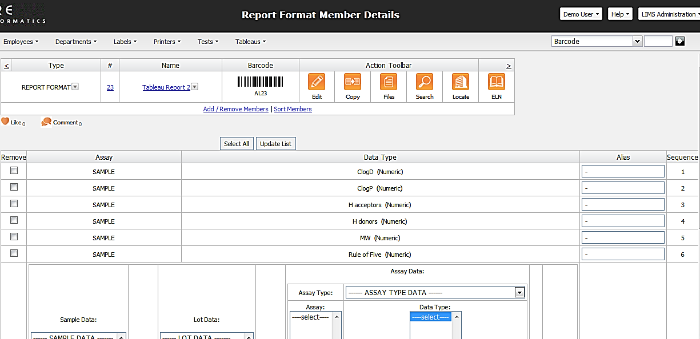
Define a Report Format
You can define a report format either from a query or from using the Create Report Format menu
The data fields you select here will be available for visualization
For better performance do not select many unneeded columns
You can create report formats for any entity type or for sample/lots/assay data

Slide 6
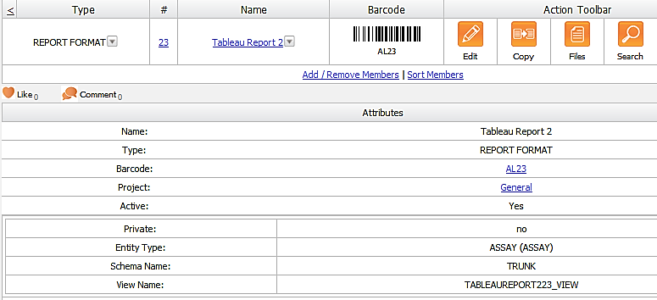
Report Formats Automatically Store Views
The report format automatically creates a view that is stored in your Core schema
Note: This is a database view NOT a materialized view

Slide 7
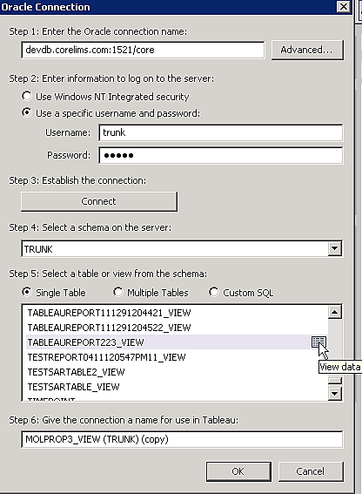
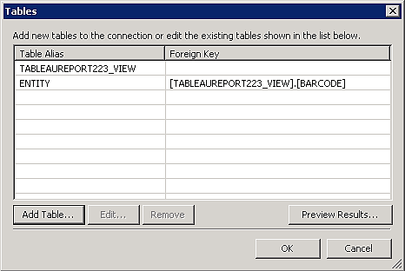
Tableau Client Easily Connects to the View
You can also join your view with other tables/views to access data you can’t get from a single report format
Tableau will help you write the Join SQL statement
You could also build visualizations from other data sources and display them in the LIMS
Select the view name from the report format record you made
Tip: You can click on the View data icon to peek at the table

Slide 8
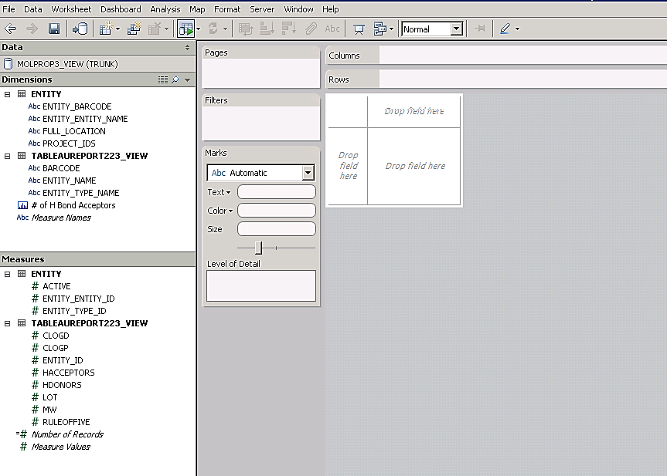
Design Your Data Visualization
Dimensions are data fields that are categorical (string)
Measures are data fields that are continuous (numeric)
Dimensions and Measures can be dragged and dropped into the main work area to create plots, filters, etc.
11/07/26
Confidential

Slide 9
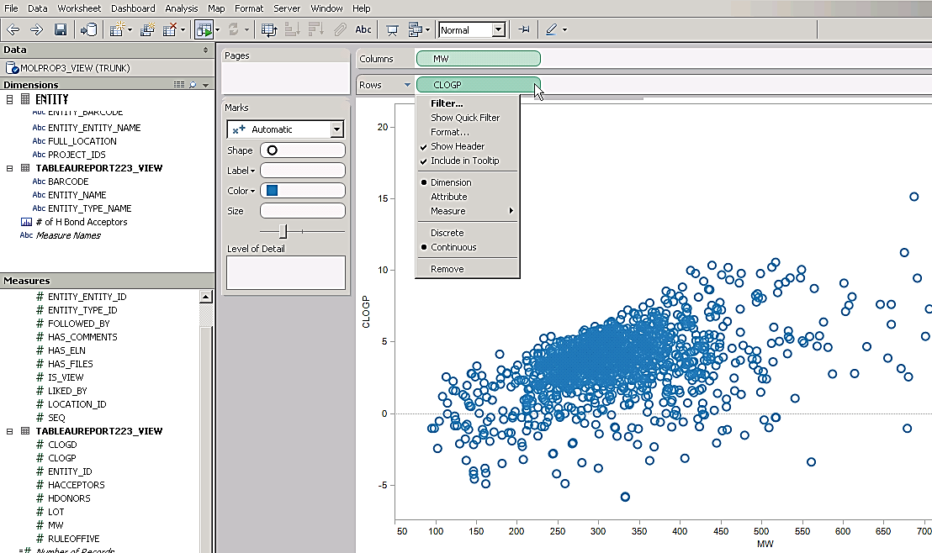
Create a Scatter Plot
Drag and drop fields to plot into the column and row shelves
You may need to specify that the field should be treated as a dimension directly (and not as an aggregate measure like count or average)

Slide 10
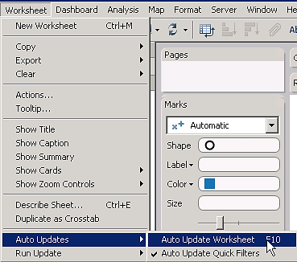
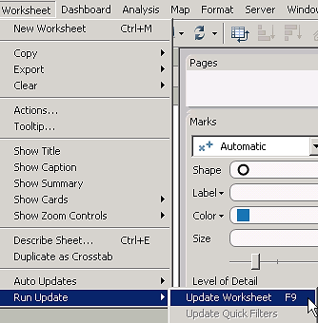
Adjust Update Settings
If your dataset is large, you may not want to re-run the database query every time you change the visualization
Toggle off the auto updates if it slows down your work
You can turn the auto update back on or run an update manually whenever you need it

Slide 11
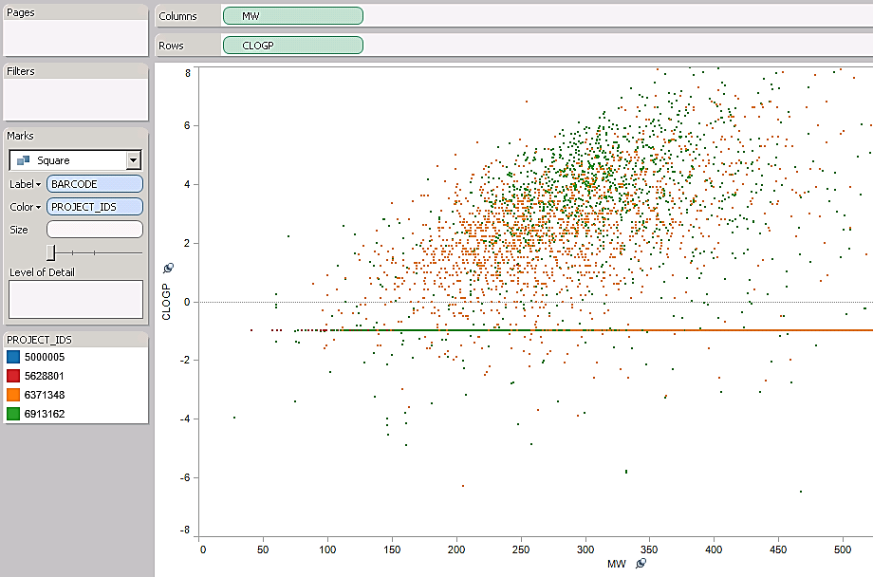
Add Colors and Labels
Drag and drop fields to color by or add to labels in mouseover tool tips

Slide 12
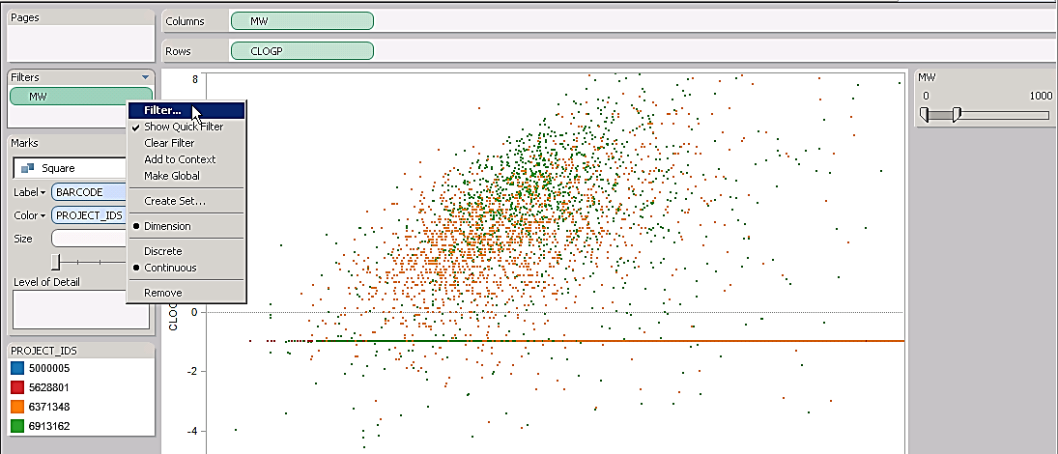
Add Filters
Drag and drop fields to filter by into the filter shelf
You can choose how filters are displayed (range sliders, checkboxes, pulldowns, textboxes, etc,)
You can set multiple filters
Filters do not have to be fields that are plotted
If you want to allow end users to use filters, toggle on Show Quick Filter
If you want to link filters across multiple plots, make them global

Slide 13
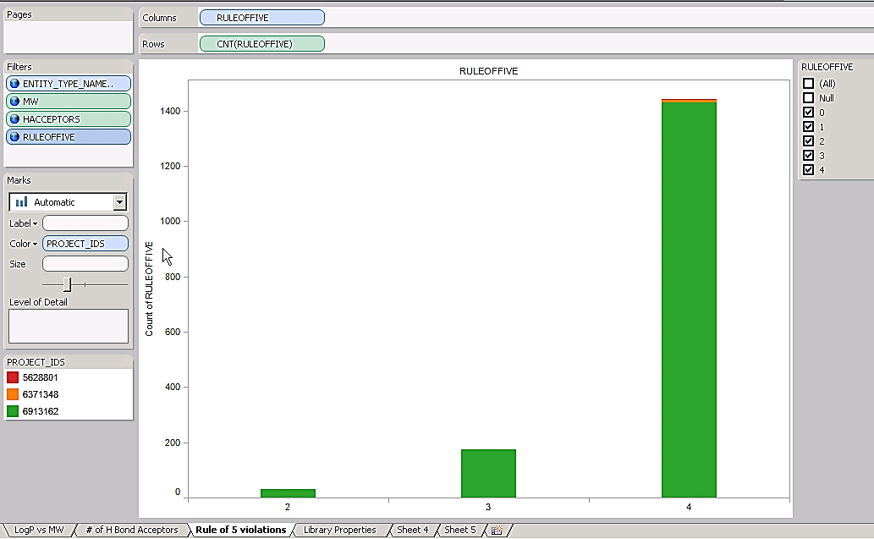
Create Histogram
You can plots aggregate values of measures (like average, sum, and count) as well as the measures directly
You can also bin values for histograms
Create each plot on a separate worksheet

Slide 14
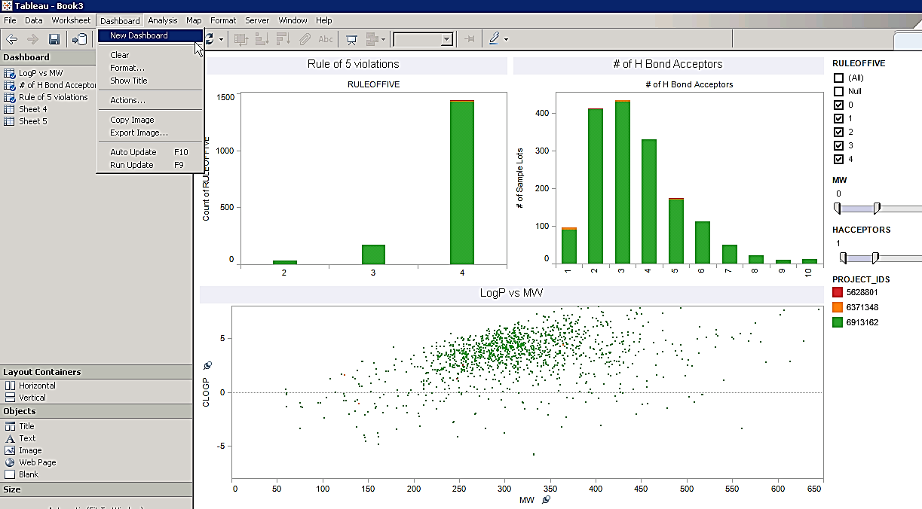
Create Dashboard
You can combine plots on a single dashboard
Drag and drop worksheets into dashboard and rearrange plots and filters as desired

Slide 15
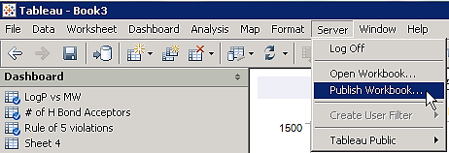
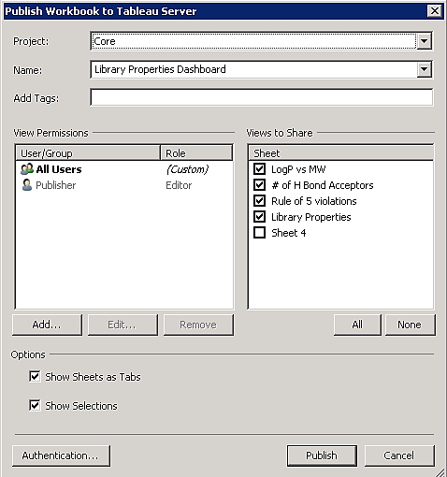
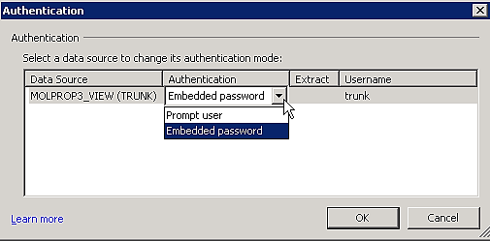
Publish Visualization
When the all your plots are designed, publish the workbook to the Tableau server
Select the plots you want
Change authentication to Embedded password so they don’t need to enter Oracle password
Click Publish when done
11/07/26
Confidential

Slide 16
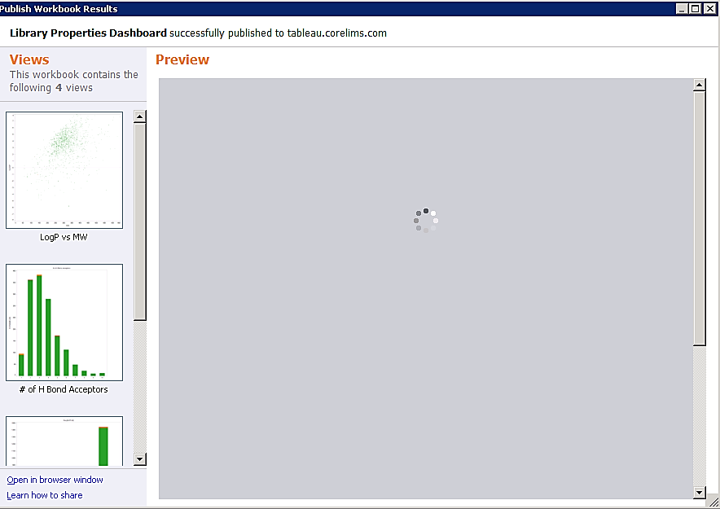
Find Design on Tableau Server
From the success window, click on hyperlink to open published visualization in browser window

Slide 17
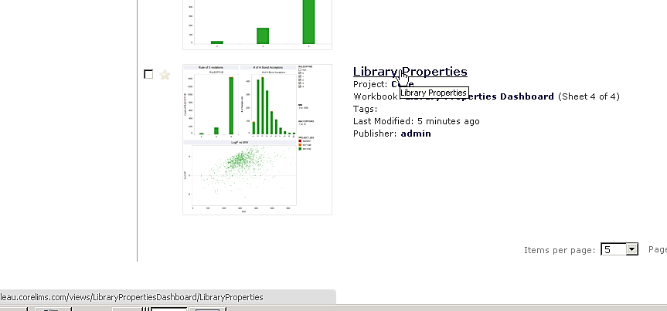
Find Design on Tableau Server
Scroll down to the page that you want to integrate into the LIMS
You can see the analysis name you need if you mouse over the title

Slide 18
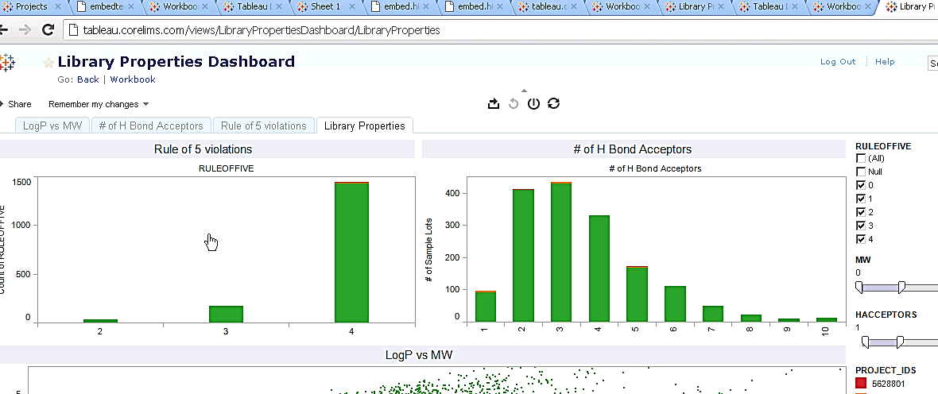
Find Design on Tableau Server
You can also find the analysis name in the URL if you open the visualization you want
The analysis name is the last 2 items in the URL path – they should be the name you entered when publishing and the name of the worksheet in the workbook you designed

Slide 19
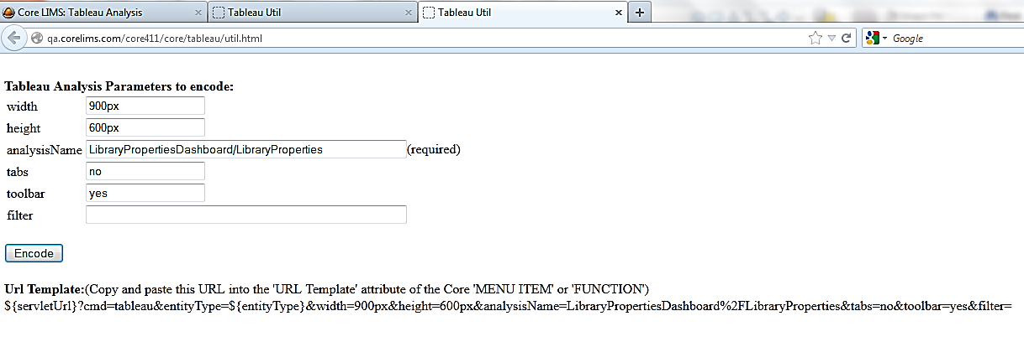
Utility to Create URL
Currently this is a stand alone utility
Enter the analysis name you got from the Tableau server and any other settings
Click on the Encode button to get a URL you can paste into the LIMS

Slide 20
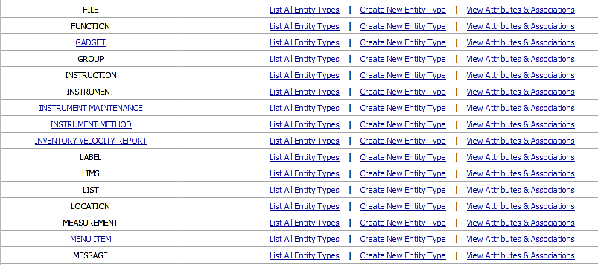
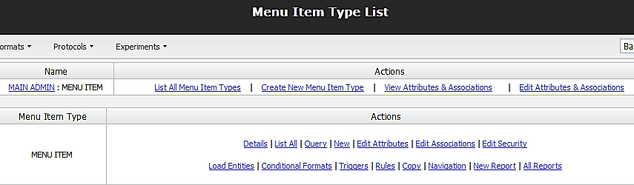
Create Menu Item or Function in LIMS
A function will display visualization from a hyperlink on a record
Create a new menu item from the Main Admin Panel to display visualization from a selectable menu
11/07/26
Confidential

Slide 21
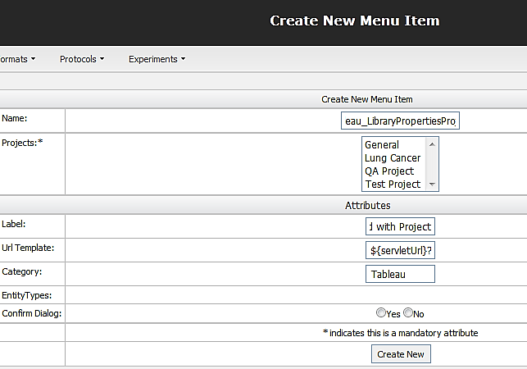
Create New Menu or Function
Assign a database name that explains what visualization does
Label is what is displayed in the menu
Paste URL generated from utility
Give a category to help find menu in a list of items

Slide 22
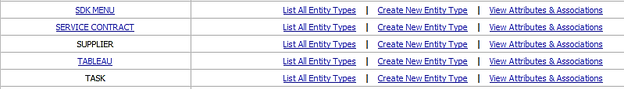
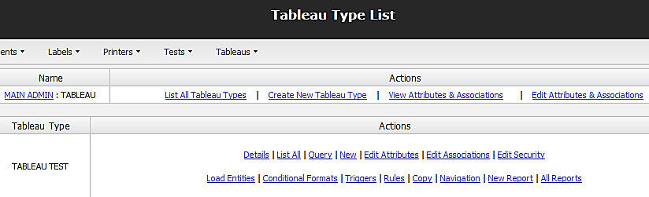
Add Menu or Function To Application
You can add a menu under an existing entity type or you can create a new super type to add a separate menu bar for all visualizations
Select Navigation on the Entity Type you want to add a menu or function to in the LIMS

Slide 23
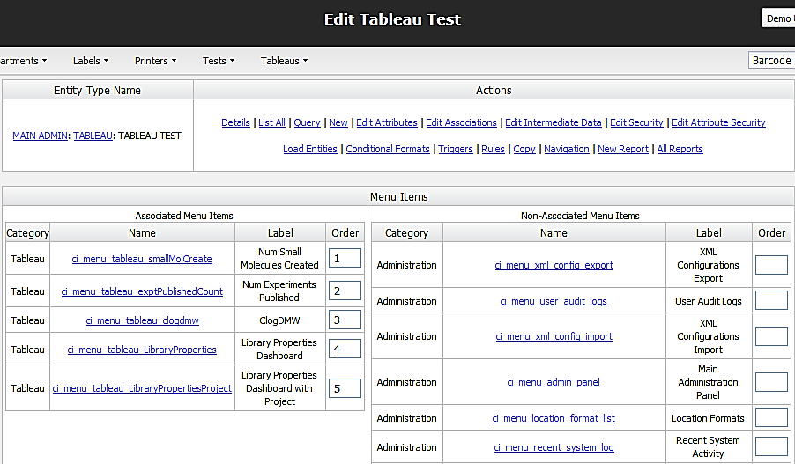
Add Menu or Function To Application
Add the new visualizations to the entity type to display them

Slide 24
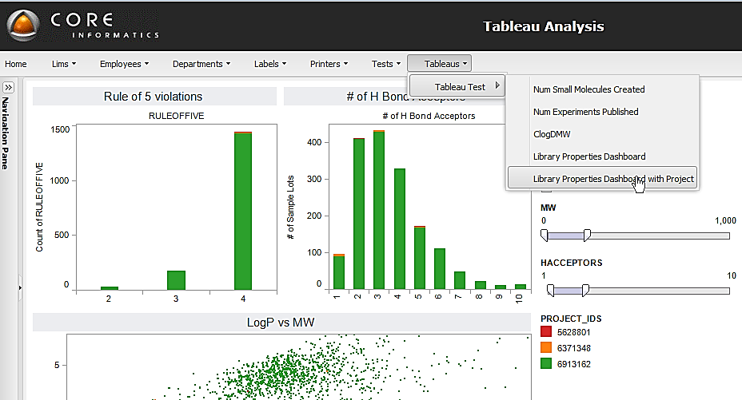
End Users Can Access Visualization from Menu

Slide 25
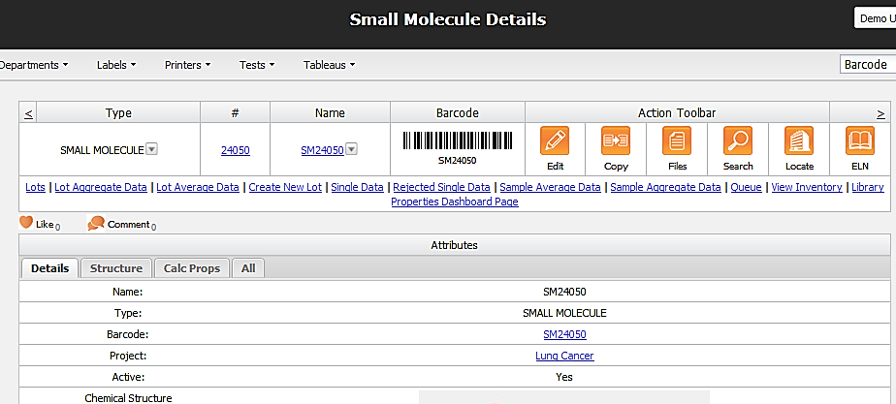
Also Access Visualizations from Hyperlinks
You can also add a function with Tableau URL to common record pages

Slide 26
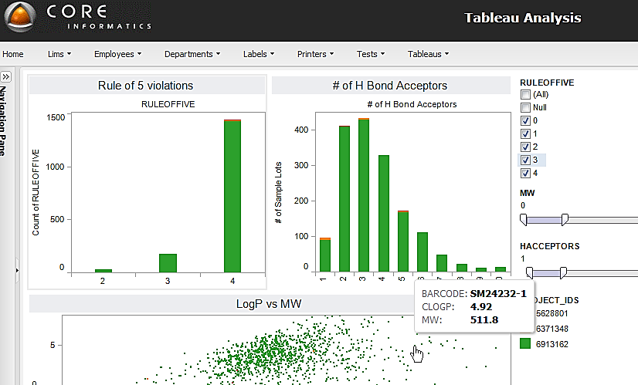
Visualizations Are Interactive
Users can change filter settings
Mouseover tool tips are interactive

Slide 27
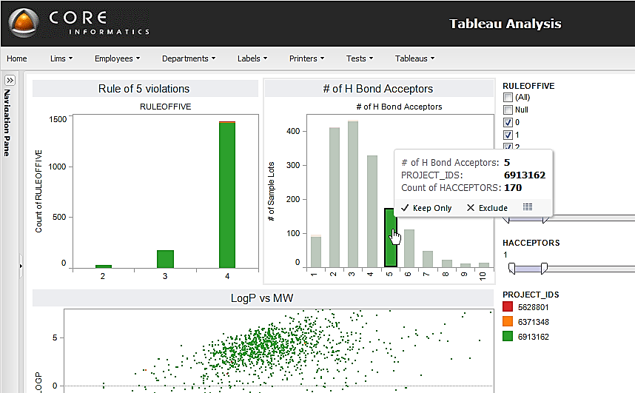
Users Can Make Selections
Highlight points or bars or legends to select data

Slide 28
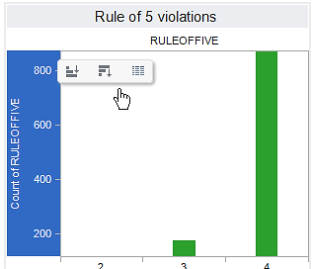
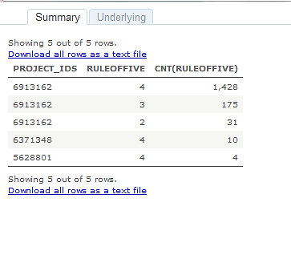
Users Can View Underlying Data
Hover over axis to get View Data Icon
Data opens in new window

Slide 29
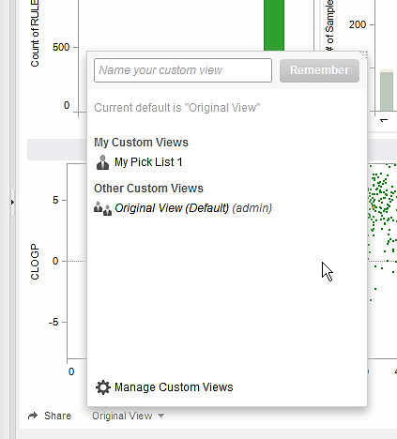
Users Can Save Changes
Save different personal views and reapply them later

Slide 30
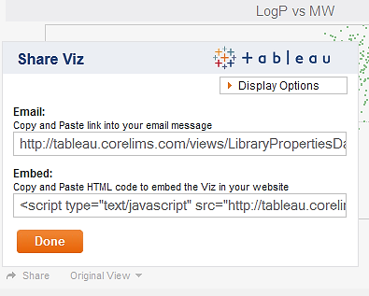
Users Can Share Views With Colleagues
Share exact personal views by sending e-mails to colleagues

Slide 31
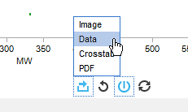
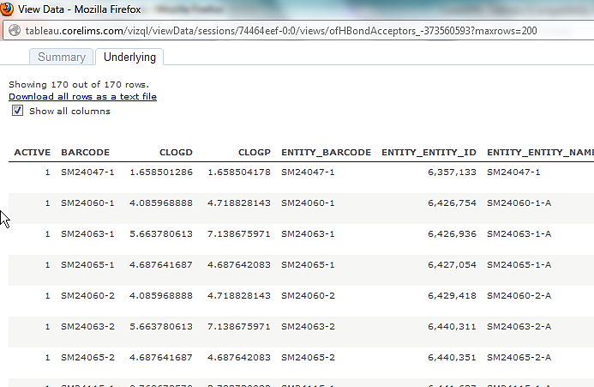
Users Can Download Selected Columns
Can export selections as a text file and paste list of barcodes into List Functions page to get reports with structures

Slide 32
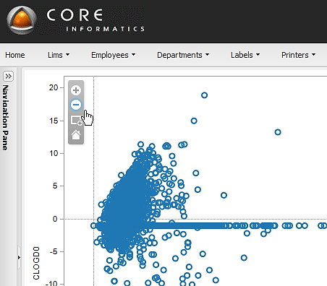
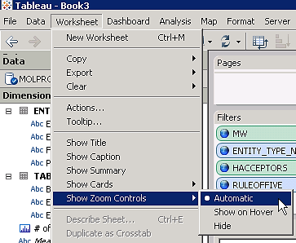
Users Can Have Zoom Controls
…But you need to give zoom to the worksheet before you publish it

Slide 33
Conclusion
Highly functional graphical interface can easily be integrated into LIMS framework
Interactive visualizations enable scientists to more quickly drill down to key data for decision-making

